Slide 1
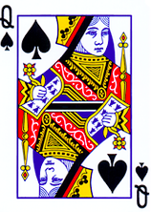
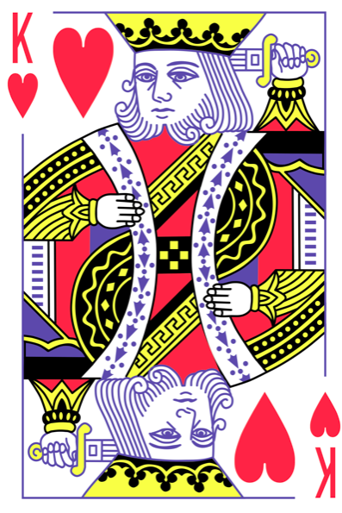
Simulation
Each person received a poker card.
The color and coat of the card signifies a specific identity in Country X.
Spade Cards are Muslim and live largely in the Eastern part of the country. They are split between two ethnic groups.
Red-faced cards are Christian and are split among 4 major ethno-linguistic groups.

Slide 2
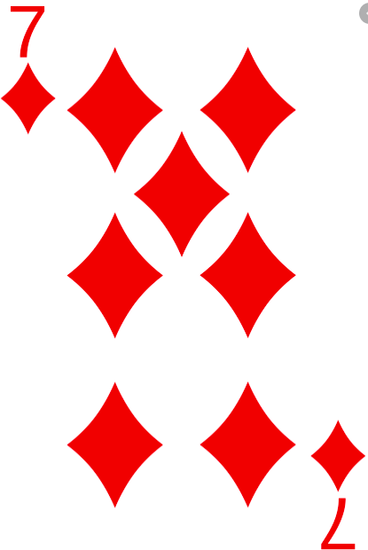
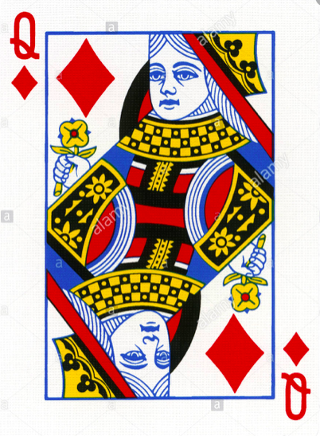
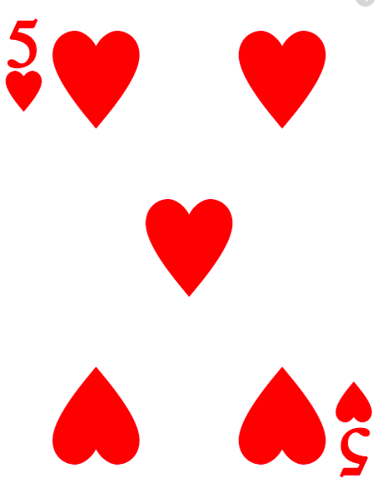
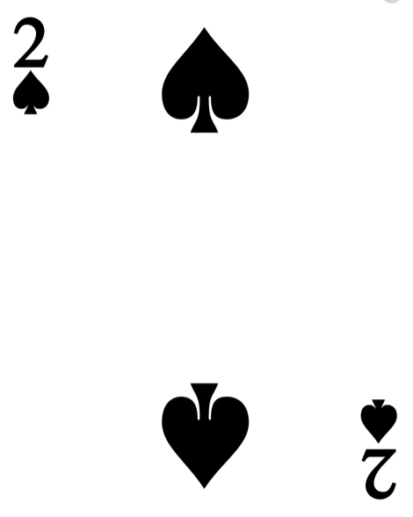
Ethnic Makeup
Group 1 makes up 37% of the population
Group 2 makes up 29% of the population
Group 3 makes up 7% of the population
Group 4 makes up 6% of the population
Group 5 makes up 20% of the population
Group 6 makes up 2% of the population

Slide 3
 |  |  |  | ✪

